Slide 1
•
COURSE POSITION 6 OF 14
Software Lifecycles & Repositories
Software & Package Management
Managed software repositories, APT and dpkg mechanics, dependency resolution, transaction review, shared libraries, and safe update planning.
2–3 Hours Duration
Ubuntu APT / dpkg Ecosystem
Target: Disposable Lab VM

Slide 2
Lab Guardrails
Learning Objectives & Lab Safety Boundaries
Disposable VM Only
Never Use -y Flag
Official Repos Only
Perform package operations strictly inside an approved course VM with a verified current snapshot.
Always inspect the proposed package changes. Never automate confirmation with in this lab.
Do not add PPAs, external repository keys, or download untrusted installation shell scripts.
-y

Slide 3
Architecture Overview
Packages, Repositories, & Dependencies
MANAGED SOFTWARE ARCHIVES
Package Archive (.deb)
Structured System Delivery
Standard compression bundle holding program files and maintainer scripts.
A package contains compiled program binaries, configuration files, and metadata including version numbers and dependency declarations.
Repository Metadata Index
Local list of package names, descriptions, versions, and checksums.
Repositories are signed network servers holding thousands of verified packages organized into searchable catalogs.
Dependency Graphs
Automatic dependency resolution ensures that prerequisites install alongside requested software.
Prevents broken runtimes by verifying required shared libraries exist.

Slide 4
Figure 6.1 Architectural Concept
The Two Tiers: APT vs. dpkg
APT (High-Level Front End)
dpkg (Low-Level Engine)
apt, apt-get, apt-cache
dpkg, dpkg-query
Unpacks individual archives, places files into local filesystem paths, executes install scripts, and tracks installed status in local database.
Communicates with configured network repositories, resolves entire dependency graphs, downloads archives, and orchestrates transaction execution.
.deb
sudo apt install tree
dpkg -s tree | dpkg -L tree
Primary Tool: Used for all routine installations, updates, and removals.
Limitation: Does not automatically download missing dependencies from network!

Slide 5
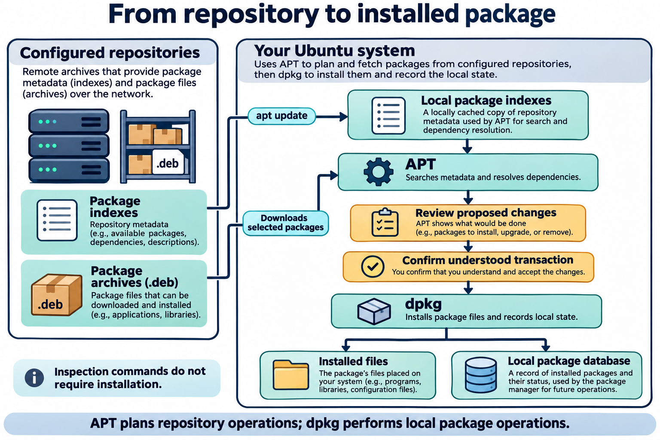

Slide 6
Figure 6.2 Lifecycle Mechanics
apt update vs. apt upgrade
METADATA SYNC ONLY
APPLYING SOFTWARE PACKAGES
sudo apt update
sudo apt upgrade
Connects to repositories and downloads the latest package catalogs and version lists.
Compares currently installed versions against the refreshed index, downloads newer packages, and installs them.
What changes: Local index files in .
Pre-requisite: Must run first to detect updates.
/var/lib/apt/lists/
apt update
What does NOT change: No installed programs or libraries are upgraded.
Release Distinction: Upgrades packages within release; not an OS version upgrade.

Slide 7
Pre-Installation Discovery
Searching & Inspecting Packages
Pre-Flight Package Queries
# Search package index
Before requesting installation, verify that the package exists, understand its purpose, and confirm its candidate source repository.
$ apt search tree
# Inspect detailed metadata
$ apt show tree
apt search : Scans local index names and descriptions.
Package: tree | Version: 2.1.1-1 | Depends: libc6
apt show : Displays size, dependencies, section, and full description.
# Verify repository origin
$ apt policy tree
apt policy : Shows installed version, candidate version, and repository pin priority.
Candidate: 2.1.1-1 | 500 http://archive.ubuntu.com/ubuntu

Slide 8
Operational Safety
The Confirmation Pause: Reviewing Transactions
1. Extra Packages
2. Removals Warning
3. Disk Consumption
Review the list of additional dependencies APT must install to satisfy package requirements.
Stop immediately if APT proposes removing unexpected packages or critical desktop libraries!
Confirm download archive size and additional disk space occupied after unpacking.
Prompt Example:
Pause and read every line before pressing Enter.
Do you want to continue? [Y/n]

Slide 9
Lifecycle Operations
Installing, Removing, and Purging Packages
INSTALLATION
REMOVAL VS. PURGE
sudo apt install tree
sudo apt remove tree
Resolves dependencies, downloads candidate , invokes dpkg to extract binaries, and updates database.
Removes executable binaries and documentation while preserving configuration files in .
.deb
/etc
: Clears binaries and configuration files.
(Purge is recognition-only in this lesson)
Provides verified files tracked in the system database.
apt purge

Slide 10
System Hygiene
Why Deleting Files by Hand is Hazardous
Database Desync
Broken Dependencies
Orphaned Leftovers
Using leaves the dpkg database believing the files are still present, corrupting package tracking.
Deleting shared libraries by hand instantly breaks other applications that rely on those exact paths.
Manual deletion misses auxiliary helper scripts, man pages, service definitions, and documentation.
rm

Slide 11
Local Package Inspection
Inspecting Package State with dpkg
dpkg -s tree
Querying Local Package State
Status: Reports whether installed, version, and architecture.
While APT coordinates remote networks, directly inspects installed files, ownership, and package state on the local disk.
dpkg
dpkg -L tree
List Files: Shows all directories, binaries, and manuals owned by package.
Inspection Scope: All dpkg queries shown here are unprivileged read-only commands and do not require .
sudo
dpkg -S /usr/bin/tree
Search Ownership: Identifies which installed package owns that specific path.

Slide 12
Runtime Dependencies
Shared Libraries & Dependency Tracing: ldd
DYNAMIC LINKING
# Inspect shared-library dependencies
Shared System Code (.so)
$ ldd /usr/bin/tree
Instead of compiling standard routines into every program, Linux applications link dynamically against shared libraries at runtime.
linux-vdso.so.1 (0x00007fffa89f7000)
libc.so.6 => /lib/x86_64-linux-gnu/libc.so.6
/lib64/ld-linux-x86-64.so.2 (0x00007f35)
The tool prints the shared libraries required by an ELF binary and their resolved filesystem locations.
ldd
# Notice core C library
libc6 provides the foundational C library runtime required by almost all user-space utilities.
Safety Rule: Run ldd only on trusted package-managed binaries (e.g., /usr/bin/tree), never on untrusted downloads.

Slide 13
Cross-Distribution Ecosystems
Major Distribution Package Families
DEBIAN / UBUNTU
FEDORA / RHEL
OPENSUSE / SLES
ARCH LINUX
APT / dpkg
DNF / rpm
Zypper / rpm
Pacman
Format:
Format:
Format:
Format:
.deb
.rpm
.rpm
.pkg.tar.zst
Massive repository ecosystem with predictable LTS release cadences.
Enterprise standard tooling (DNF evolved from legacy YUM).
Fast dependency solving with libzypp backend integration.
Continuous rolling-release updates with minimal package patching.
Cross-Platform Note: Package formats and manager syntaxes differ across families; commands are not drop-in replacements.

Slide 14
Trust & Security
Software Provenance & Safe Maintenance
GPG Cryptographic Signing
PPA & Script Risks
Maintenance Rollback Plan
APT checks digital signatures on repository release files to ensure software was not altered in transit.
PPAs grant root installation authority to third parties. Never pipe uninspected curl downloads into .
Before applying major upgrades: create a verified VM snapshot or backup, refresh index, and review changes.
sudo bash

Slide 15
Hands-On Practice
Student Lab: 6-Part Workflow
PART A
PART B
PART C
PART D
PART E
PART F
Update & Search
Inspect Origin
Review & Install
dpkg Queries
Inspect ldd
Safe Removal
& search for package.
Run & .
Pause at prompt, read summary, & confirm.
Inspect status with , files with , path with .
Check shared libraries with .
Run & verify removal.
sudo apt update
apt show tree
-s
sudo apt remove tree
tree
apt policy tree
-L
ldd /usr/bin/tree
-S

Slide 16
LESSON 6 REVIEW
Key Concepts & Exit Ticket
"The critical difference between apt update and apt upgrade is ______, and I must always inspect ______ before confirming any package transaction."
APT vs. dpkg Roles
Shared Libraries & ldd
Next: Lesson 7 (Shell Scripting & Automation)

